Slide 1


Slide 2
TOPIC: DECISION TABLE TESTING
PRESENTED BY:
SANNIA AMIN (02-131192-068)
SAMIULLAH KHAN (02-131192-071)

Slide 3
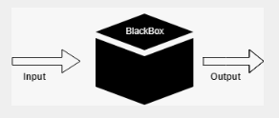
WHAT IS Decision Table Testing.
Decision Table Testing is a Black Box test design technique (behavioral or behavior-based technique), used where different combinations of test input conditions result in different outcomes. When a system has complex business rules, then the decision table testing technique helps in identifying the correct test cases. As a result, it helps us to validate if the application/system can handle all the possible combinations of input data.
The Decision Tables consists of CONDITIONS and ACTIONS which are also termed as INPUTS and OUTPUTS of a system. The representation of Conditions and actions will be in the form of Table.

Slide 4
WHEN WE USE ?
WHY WE USE ?
Decision tables are very much helpful in test design technique. It helps testers to search the effects of combinations of different inputs and other software states that implement business rules. It provides a regular way of stating complex business rules which benefits the developers as well as the testers. Conversion of complex business rules into simple decisions tables which the business users, testers and developers may use.
NOTE : STATIC BUSINESS RULES: BUSINESS RULES THAT CAN BE VERIFIED AT ANY POINT IN TIME
Decision tables can be used in all situations where the outcome depends on the combinations of different choices, and that is usually very often. Because it helps to test different combinations of conditions and provide better test coverage for complex business logic.
When testing the behavior of a large set of inputs where system behavior differs with each set of input, decision table testing provides good coverage and the representation is simple, so it is easy to interpret and use.

Slide 5
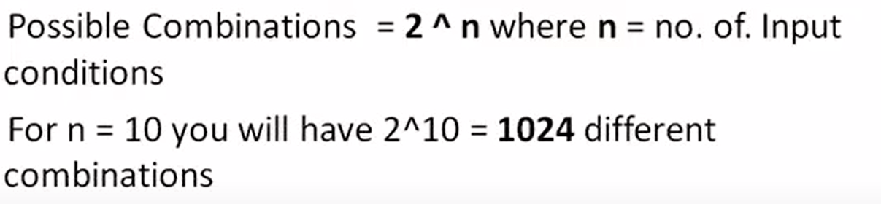

FORMULA (COMBINATION)
No. of Combinations= No of Condition 1 values*No of Condition 2 values*No of Condition 3 values
THE MAIN DISADVANTAGE IS THAT WHEN THE NUMBER OF INPUT INCREASES THE TABLE WILL BECOME MORE COMPLEX

Slide 6
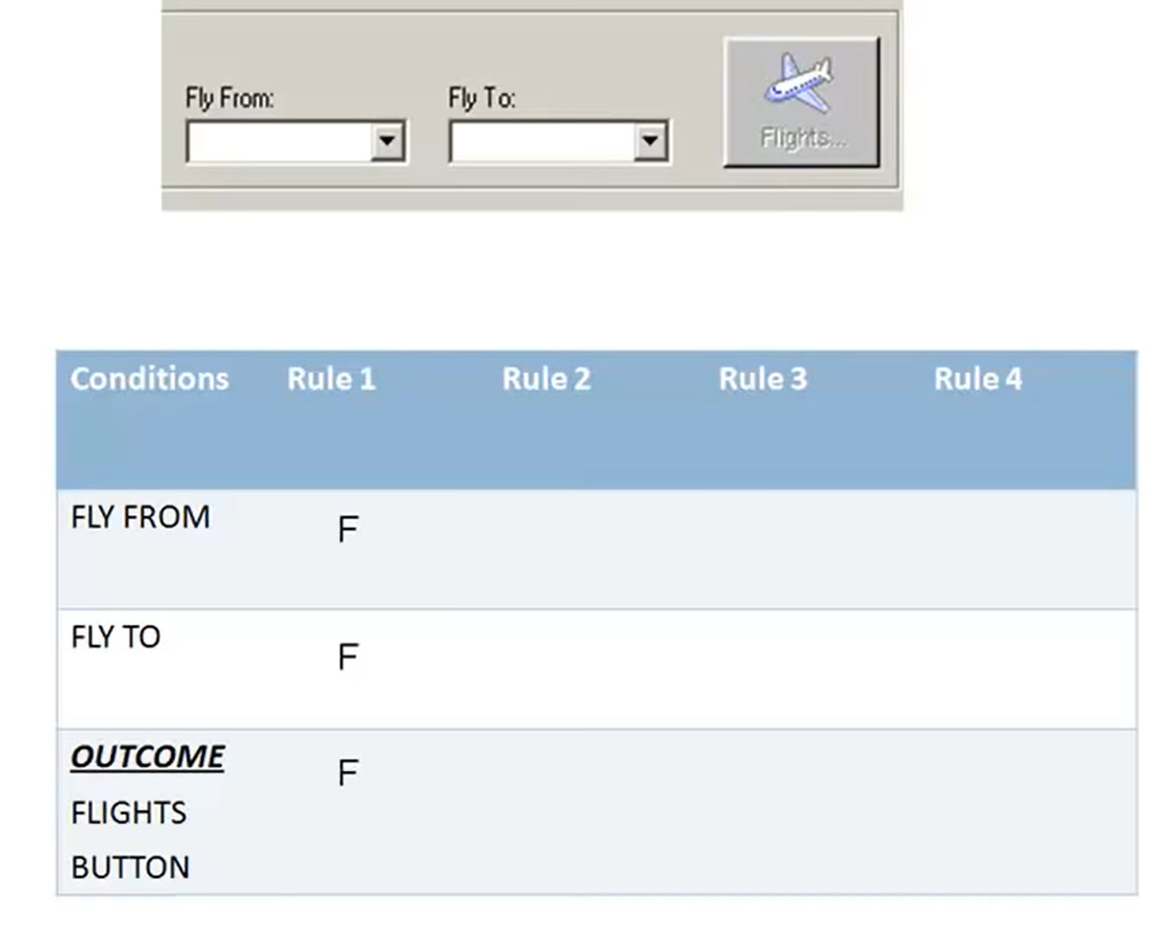
EXAMPLE #01

Slide 7
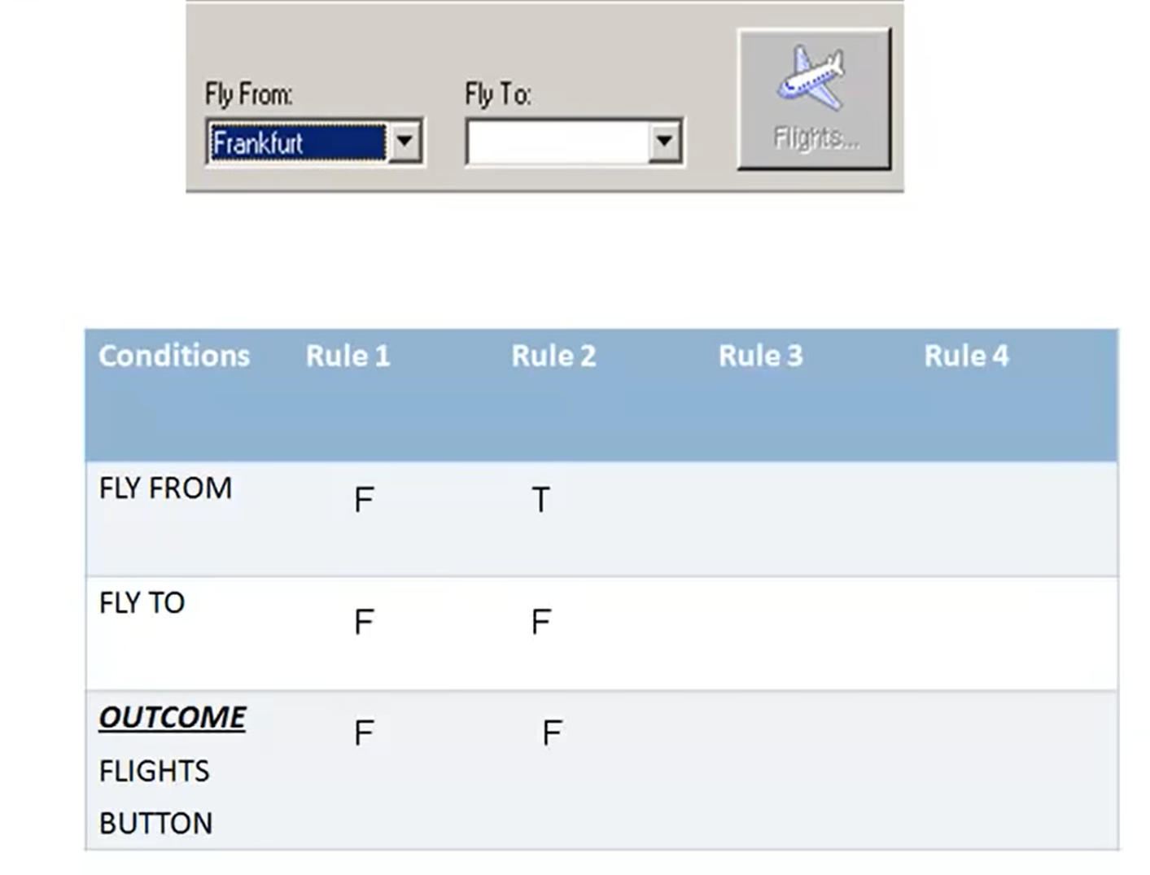
EXAMPLE #01

Slide 8
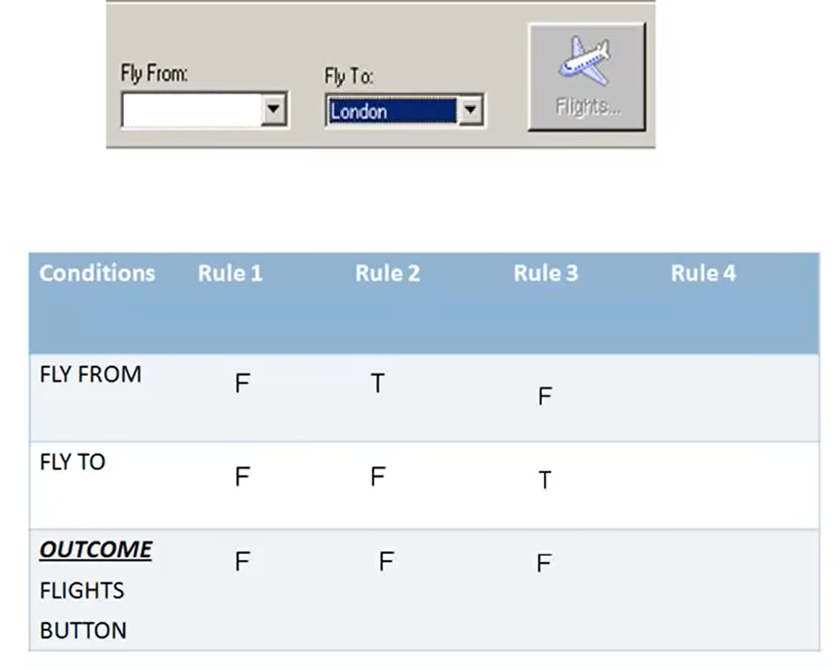
EXAMPLE #01

Slide 9
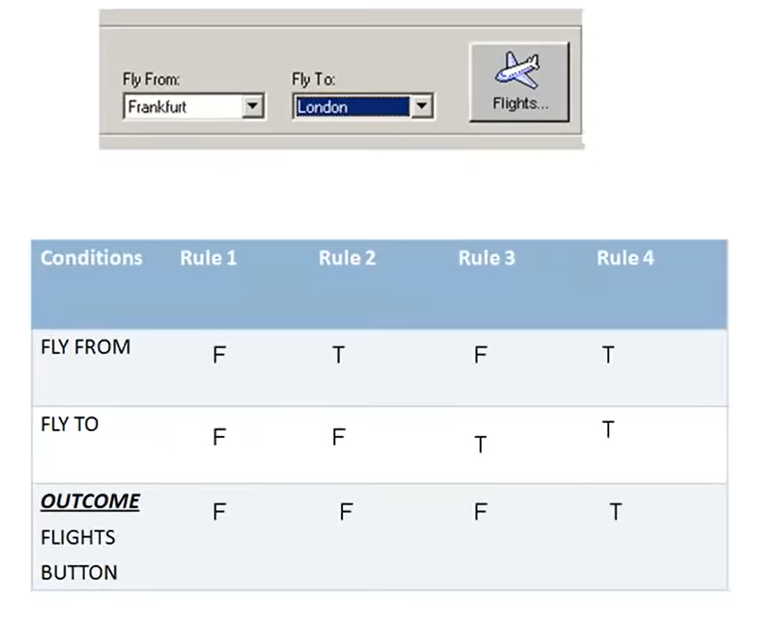
EXAMPLE #01

Slide 10
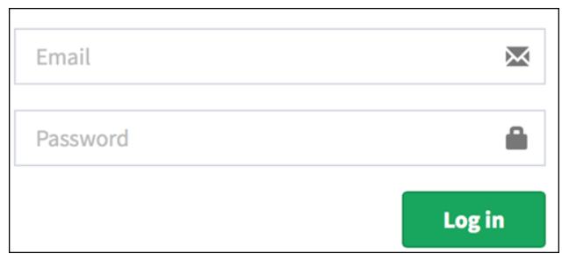
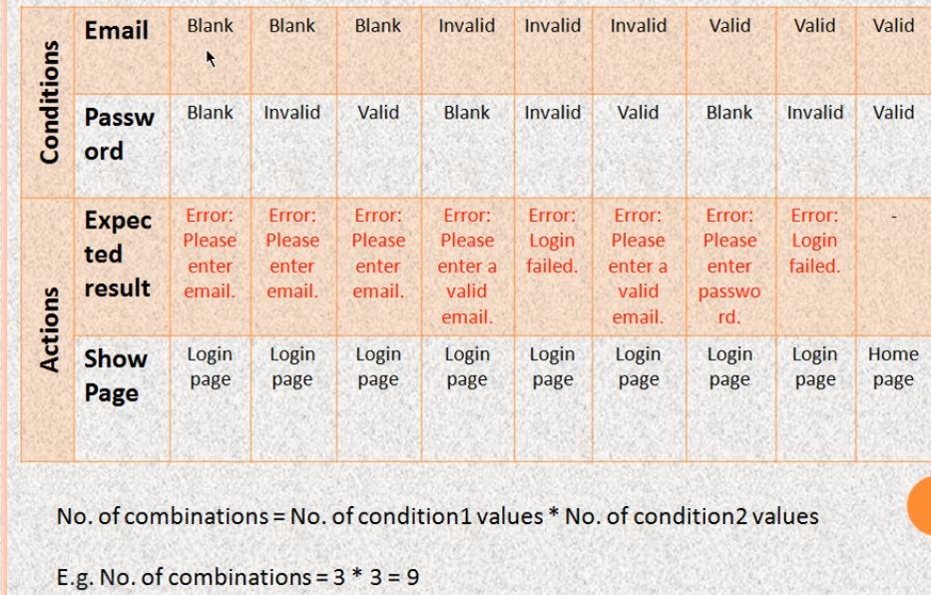
EXAMPLE

Slide 11
EXAMPLE #02
 | RULE1 | RULE2 | RUL3 | RULE4
CONDITIONS
NEW CUSTOMER (15%) | TRUE | FALSE | FALSE | FALSE
LOYALTY CARD (10%) | FALSE | TRUE | FALSE | FALSE
COUPON (20%) | FALSE | FALSE | TRUE | FALSE
ACTION
DISCOUNT | 15% | 10% | 20% | 0%

Slide 12
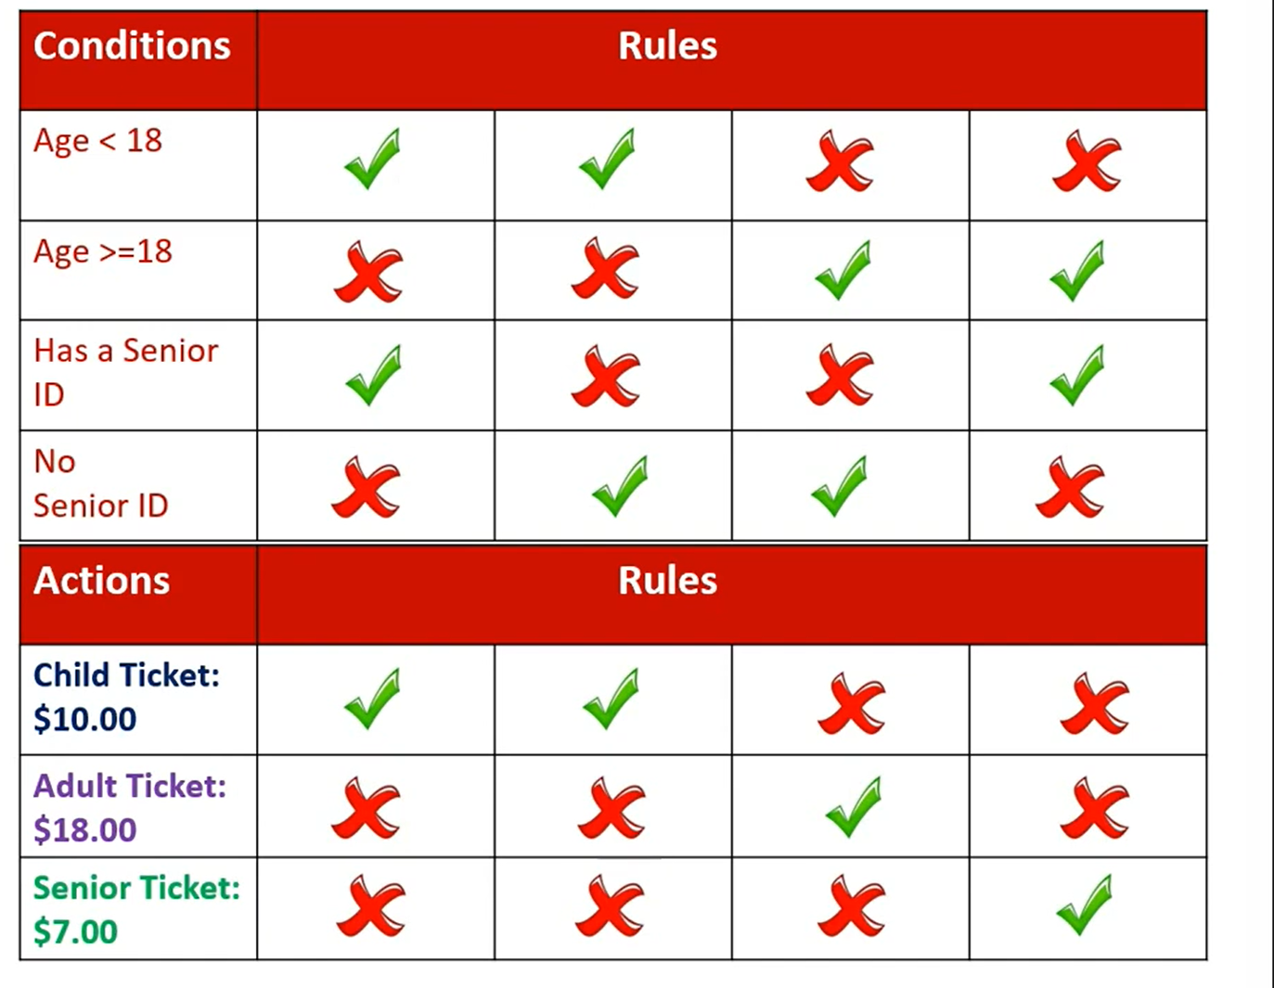
Purchasing movie tickets online

Slide 13
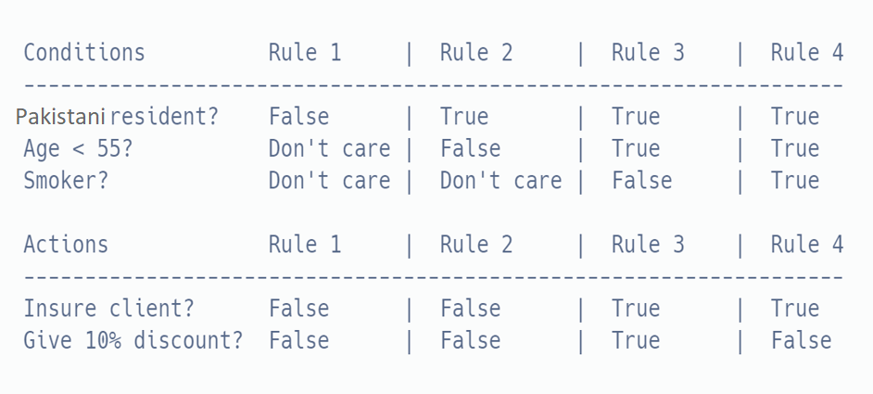
EXAMPLE #03

Slide 14
EXAMPLE #04 COLLAPSED DECISION TABLE
When we try to validate the system with all possible combinations of data, the table becomes vast. Validating with huge data is a very time-consuming factor and also sometimes become impossible to test. Hence, the tester should follow specific rules to reduce the test data without affecting the test coverage intelligently.
Once a decision table is made with all the combinations of condition and actions, the table is shrunk by deleting the following columns:
Impossible combinations of actions and conditions
Possible, but infeasible combinations
Combinations that do not affect the outcome
The minimum coverage for a decision table is at least one test case per a decision rule.
Coverage % = The number of decision rules tested by at least one test case / The total number of decision rules.

Slide 15
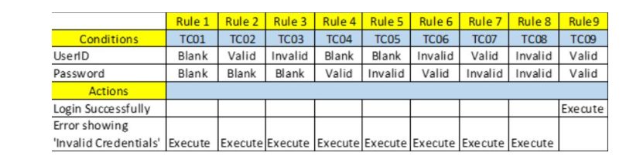
Consider a ‘Login’ Page Functionality.
Here are the business rules.
On entering correct combination of ID & Password, user should be able to login successfully.
User is not allowed to login when any or both of the ID & Password are incorrect /blank. In such cases, it should show ‘Invalid Credentials’ message.
We created the following combinations of Conditions, Actions and the respective rules in the decision table.
2 conditions – User ID, Password
2 Actions – Login Successfully, Error showing ‘Invalid Credentials’ and
3 Options — Blank, Valid, Invalid.

Slide 16
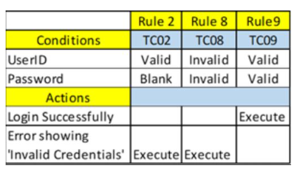
So, let us try to reduce the number of test cases.
Rules 1,2, 3, 4, and 5 cover the same action Item “Invalid Credentials” with options Blank and Invalid. Hence, we can consider any one of these test cases TC01 OR TC02 OR TC03 OR TC04 OR TC05
Rules 6,7, and 8 cover the same action Item “Invalid Credentials” with options Valid and Invalid. Hence, we can consider any of these test cases TC06 OR TC07 OR TC08
Rule 9 covers the action item “Login Successfully” with all valid options. Hence, we should consider the test case TC09.

Slide 17


